Slide 1
Introduction
Children are not born to become juvenile criminals or gang members that lead to delinquency. Juveniles in lower income areas usually experience poverty, abuse, and drugs in their community's. When juveniles are in these areas, many times the families are not stable, have a lack of structure, and lack affirmation in which follows juveniles to school that will lead to a lack of academic achievement. These juveniles look for a place to belong and a lot of times turn to gangs. ("National Crime Prevention Teens Crime and the Community (TCC)," n.d.).
Identifying how selected programs can meet the elements of solving the problem for juvenile gangs and their behavior is crucial along with the effectiveness of a program that works. Explaining how a problem-solving model and its impact on effectiveness will be established along with the objective in this presentation.
Notes:
Introduction
Children are not born to become juvenile criminals or gang members that lead to delinquency. Juveniles in lower income areas usually experience poverty, abuse, and drugs in their community's. When juveniles are in these areas, many times the families are not stable, have a lack of structure, and lack affirmation in which follows juveniles to school that will lead to a lack of academic achievement. These juveniles look for a place to belong and a lot of times turn to gangs. ("National Crime Prevention Teens Crime and the Community (TCC)," n.d.).
Identifying how selected programs can meet the elements of solving the problem for juvenile gangs and their behavior is crucial along with the effectiveness of a program that works. Explaining how a problem-solving model and its impact on effectiveness will be established along with the objective in this presentation.

Slide 2
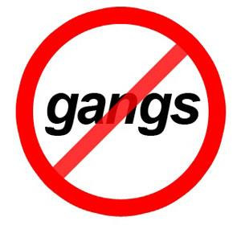
Juvenile Gangs
Gang prevention and the overview of the programs
Reasons for gang involvement are: protection of the enjoyment, the respect, the money and friends.
The youth is at higher risk of joining a gang, delinquent behaviors,
Aggressive
Violent
Problems at school
Live in the communities where is unsafe and the trouble will get all the youth involved
Notes:
Juvenile gangs in America - youth gang members commit a disproportionate share of offenses, including nonviolent ones. Youth join gangs for protection, enjoyment, respect, money, or because a friend is in a gang. Youth are at higher risk of joining a gang if they engage in delinquent behaviors, are aggressive or violent, experience multiple caretaker transitions, have many problems at school, associate with other gang-involved youth, or live in communities where they feel unsafe and where many youth are in trouble. To prevent youth from joining gangs, communities must strengthen families and schools, improve community supervision, train teachers and parents to manage disruptive youth, and teach students interpersonal skills.

Slide 3
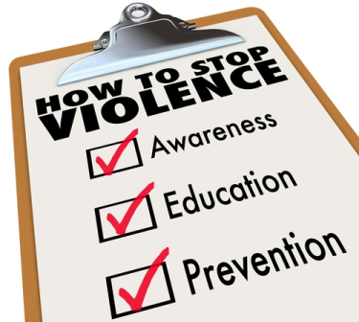
Prevention
Strengthen the families
Strengthen the school
Improve community supervision
Train teachers
Help parent manage the disruptive youth
Teach the youth interpersonal skills
Notes:
Coordinated intervention Involvement of police agencies, educators, job-training resources, parents, and community groups are essential to the success of the likelihood that high-risk youth will not become involved in gangs. Youth violence is a significant public health problem with serious and lasting effects on our young people, families, and communities. But, it is not unavoidable or inevitable. Youth violence can be prevented.

Slide 4

Guides
Community gang problems and the implementing intervention and the prevention strategies
The juvenile justice and the delinquency prevention comprehensive gang model
National gang center www.nationalgangcenter.gov/publications
Gang violence in the country of all 50 states have increased over the last 5 to 7 years
Steady growth
Gang prevention
Usually about 9,000 youth in the gangs
Ages 12-17
Gang members and the locations
Kansas City Mo percentage 10.1 Orlando, FL percentage 9.6 Providence, RI percentage 6.0
Las Cruces NM percentage 11.0 Philadelphia, PA percentage 7.7 Torrance, CA percentage 6.3
Milwaukee, WI percentage 15.4 Phoenix, AZ percentage 12.6 Will County, IL percentage 3.8
Omaha, NE percentage 11.4 Pocatello, Id percentage 5.6 Over all percentage is 9.1
Notes:
The National Gang Center (NGC) is a project jointly funded by the U.S. Department of Justice’s (DOJ) Office of Juvenile Justice and Delinquency Prevention (OJJDP) and the Bureau of Justice Assistance (BJA). The NGC program works to further the mission of DOJ by providing an array of information and resources on gangs for state, local, and tribal jurisdictions. NGC’s national leadership serves researchers, policymakers, direct service providers, criminal justice practitioners, and other community members through peer-to-peer information exchange and mentoring, training, and on- and off-site technical assistance. NGC activities contribute to reductions in gang-related crime and violence and gang activity by juveniles and adults.

Slide 5

RACE
2008
  50% is Hispanic/Latino
  32 % is African American
  11% is Caucasian
2010
  Whites 7.3 %
  Blacks 8.3 %
  Hispanics 9.0 %
  12.9 % Multi racial
Gender
  2 to 1 males vs females
  11 percent males vs 6 percent females
Notes:
The connection between race/ethnicity and gang membership has long existed. Early gang members traditionally came from white ethnic immigrant groups such as the Irish and Polish, whereas starting in the 1950s, we have seen gang membership increasingly concentrated among racial minorities such as African-Americans, Hispanics, Asians, and American Indians.

Slide 6
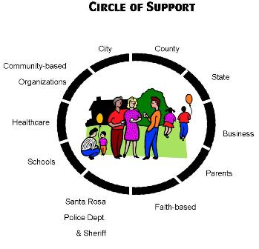
Risk Factors
Antisocial Behavior
Alcohol and drug use
Mental health problems
Victimization
Negative life events
Ethnicity
Popular culture
Friendship
Romantic relationships
Family risk factors
School risk factors
Peer group risk factor
Community risk factors
Notes:
Communities cannot address gang-joining among minority populations without fully understanding the factors that influence risk. racially and ethnically specific gang-membership prevention programming may not be necessary but rather, that general prevention programming, which includes racially and ethnically sensitive elements, may be sufficient.

Slide 7
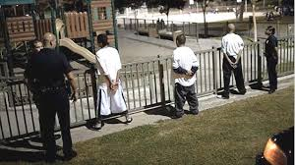
Project Safe Neighborhoods
Hires new federal and state prosecutors
Provides gun safety kits
Deters gun crimes and gang activity
Promotes community relations to support reduced gang violence strategies
Notes:
Project Safe Neighborhoods is a program initiated by the United States Department of Justice. This program is designates to reduce gang violence by promoting community relations and develop strategies to reduce violent activity. “$2.5 million is dedicated to each of 10 sites for an anti-gang pilot program devoting extensive resources to reaching ex-offenders with past or probable future involvement with some of the most violent and pervasive gangs in the country. This program focuses on prevention, targeted enforcement, and reentry of prisoners back into society” (US Department of Justice, 2017).

Slide 8
In Summary
Juvenile delinquency requires the assistance of the entire society to be in control of the direction of these future eras. Furthermore, a range of group-based plans for the redirection of youngsters far from perpetrating wrongdoings can be directed. It incorporates group mind, direction, advising child care and preparing social exercises, and group improvement. These are only a few of the conceivable methods for helping the adolescents (Burfeind, 2015).
Notes:
To conclude it can be said that, undoubtedly Juvenile delinquency is a serious matter of concern and a major challenge for the justice system. But, if proper steps are taken it can be reduced and avoided to a great extent with the mix efforts of both society and administration.

Slide 9
References
Burfeind, J. (2015). Juvenile Delinquency: An Integrated Approach. Routledge.
Cohen, A.K., and Ohlin, L.E. 1960 Delinquency and Opportunity
  www.universityofphoenix.com (class discussion) Team D
Gang Prevention: An Overview of Research and Programs Retrieved from
  https://www.ncjrs.gov/pdffiles1/ojjdp/231116.pdf
National Crime Prevention Teens Crime and the community (TCC). (n.d). Retrieved from
  http://www.ncpc.org/programs/teens-crime-and-the-community/publications-1/adult2pdf
United States Department of Justice. (2017). At Risk Youth and Gang Prevention. Retrieved from
  https://www.justice.gov/archive/fbci/progmenu_atrisk.html

